Slide 1
Social Media Initiative
Faces of HAAG Project Spotlight Blog Posts Event Promotion
Jacob McGivern (Manager) Sheena Patel (Manager) Neelima Pandey (Lead)

Slide 2
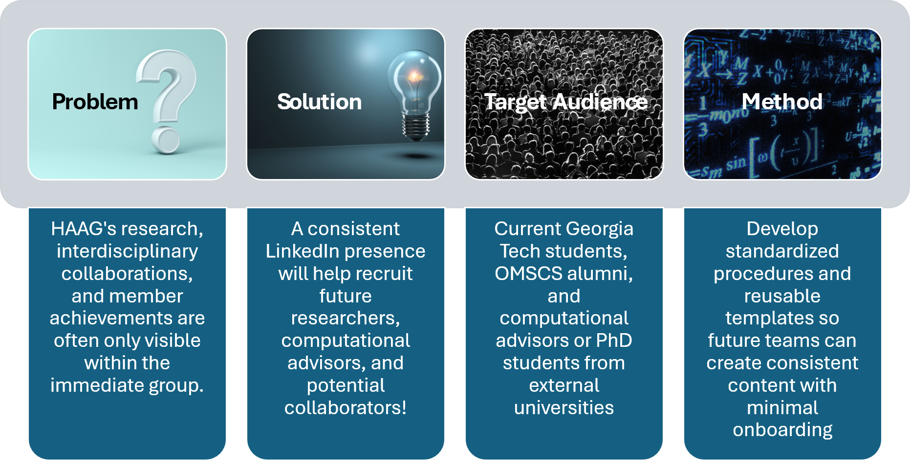
Why Address the Problem

Slide 3
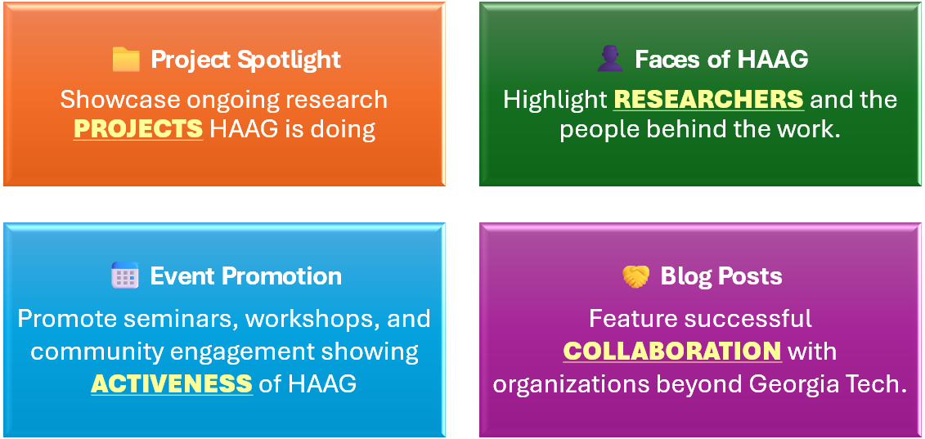
What Goes Out on LinkedIn

Slide 4
INITIATIVE OVERVIEW
Context and Goals
The problem we addressed
The scope of our work
Right now, it is not very clear where the feedback is being sent, how to be able to access it, and what the steps are to follow afterward.
Faces of HAAG and Project Spotlight — two LinkedIn content streams, each with its own template, tracker, and post-feedback process.
What each template is for
Project Spotlight
Faces of HAAG
To act as a template and provide guidelines for generating a “Project Spotlight” post on LinkedIn for the HAAG organization.
To act as a template and provide guidelines for generating a “Faces of Haag” post on LinkedIn for the HAAG organization.
This pipeline even includes blank placeholders for specific steps of the pipeline so that anyone could use this template and follow it with limited oversight.

Slide 5
DELIVERABLES
Work Completed
Project Spotlight
Faces of HAAG
LinkedIn Post Template / Script
LinkedIn Post Template / Script
A four-phase pipeline with blank placeholders, fill-in-the-blank tracker fields, and worked examples.
A four-phase pipeline with blank placeholders, fill-in-the-blank tracker fields, and a worked example.
Post Feedback and Approval Process
Post Feedback and Approval Process
A dedicated process to use for every single draft before anything gets posted on LinkedIn.
A dedicated process, including temporarily adding the featured person to the channel.
Implementation Pilot
Implementation
The process tested on a written draft, with outcomes, limitations, and next steps recorded.
Not yet piloted this semester. Planned across a fully revised procedure — see next steps.

Slide 6
01
Faces of HAAG
Procedure, implementation status and reflection

Slide 7
FACES OF HAAG · PROCEDURE DEVELOPMENT
Procedure — The Standard Pipeline
Why this procedure exists
The objective of the Faces of HAAG document is to act as a template and provide guidelines for generating a “Faces of Haag” post on LinkedIn for the HAAG organization.
This procedure exhibits a pipeline with four phases. These four phases are comprised of sourcing, content, collection, translation, and promotion.
1
Sourcing
Selection of a person within the HAAG organization.
2
Content Collection
Perform outreach and do a short Q&A session.
3
Translation
Translate the answers from the Q&A session into a LinkedIn post.
4
Promotion
Publish the post, tag it, and do a follow-up.
Before the LinkedIn post gets published, there must be someone other than the writer of the post who will check the tags and accuracy of the post.

Slide 8
FACES OF HAAG · PROCEDURE DEVELOPMENT
Phase 1 — Sourcing
How to source a person
Choose a researcher, advisor, or faculty member. The candidate can also be a new team member speaking on why they joined HAAG. Candidates can also be pulled from HAAG leadership/project-lead recommendations, the HAAG project registration sheet, and the HAAG Summer Enrollments spreadsheet.
Finally, also preserve an ongoing list of future projects and candidates to have a sustainable content pipeline, along with keeping track of who and which project has already been spotlighted or opted in or out.
Fill In the blanks — Candidate / Project Selected
Name of Person: ______________________ Point of Contact: ______________________
Sourced From: ☐ Faculty Recommendations ☐ HAAG Project sheet list ☐ Other: ______
Agreed to Participate: ☐ Yes ☐ No ☐ Undecided

Slide 9
FACES OF HAAG · PROCEDURE DEVELOPMENT
Phases 2, 3 and 4 — Collect, Write, Promote
Phase 2 — Content Collection
Phase 3 — Translation
Phase 4 — Promotion
The basics — Who are you, in 1–2 sentences?
The why — What drew you to this research?
Who’s involved — Who do you work with at HAAG?
The milestone — What’s something you’re proud of recently?
What’s next — What’s next for you?
Visual — A photo of you.
Hook — One line about you, in your own words.
Body — Your background and what draws you to the work.
Credit line — Tag yourself, this one’s about you.
Close — A personal note, what’s next for you.
Visual — A photo of you.
Publishing is the midway point, not the finish line.
Tagging — Tag the person.
Resharing — They share it themselves, in their own voice.
Engagement — Invite HAAG Slack to engage; someone from HAAG responds to comments.
Reuse — Eligible as a baseline for a future blog post.

Slide 10
FACES OF HAAG · PROCEDURE DEVELOPMENT
Post Feedback and Approval Process
Please use this post feedback and approval process for every single draft before anything gets posted on LinkedIn.
Step 0
The person getting featured in the Faces of HAAG will be temporarily added to the post-feedback slack channel to provide feedback on the draft revisions.
Step 1
Upload the draft inside the #post-feedback channel in Slack. Please use the dedicated folder for the uploads of the drafts.
Step 2
Then make an announcement in the #post-feedback channel when the draft is ready, along with providing instructions for how to make comments within the draft.
Step 3
Make sure to allow a 48-hour period for annotations, revisions, and feedback about the draft.
Step 4
Review and gather all the feedback by having a thread attached to the draft. This is for keeping the feedback organized and to reduce the number of DMs.
Step 5
Finally, the writer of the draft will review and analyze all the feedback received by editing and updating the draft.
Once the 48-hour period is complete, the draft must be approved by Bree, faculty, or a team leader before the draft is posted on LinkedIn.

Slide 11
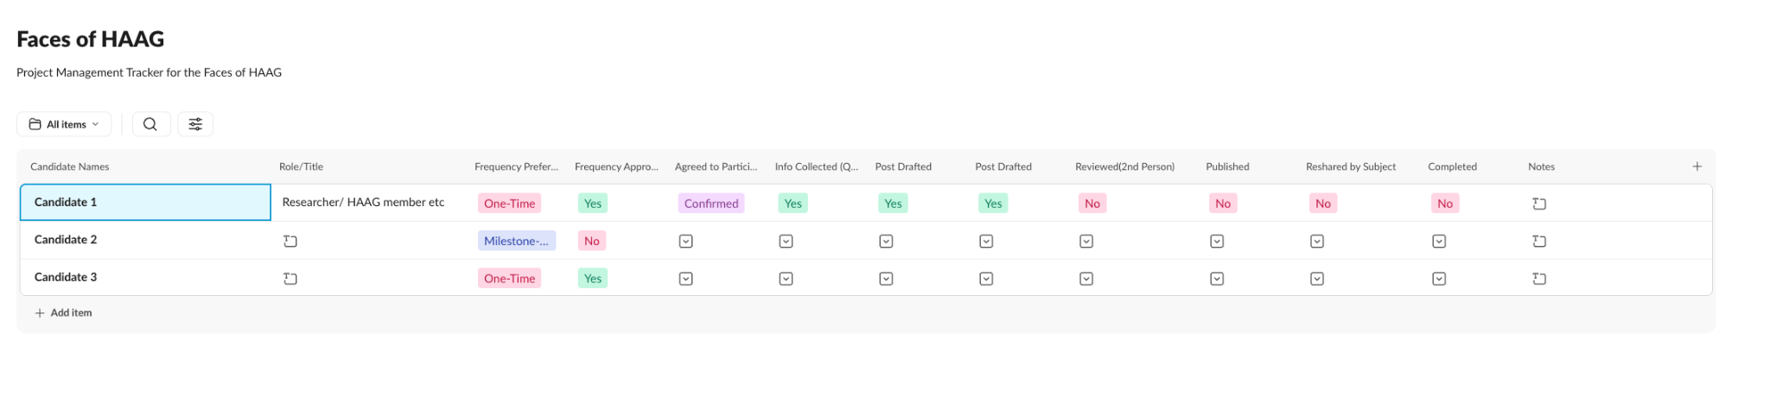
Faces of HAAG Tracker
Tracker

Slide 12
FACES OF HAAG · IMPLEMENTATION & REFLECTION
Implementation Status and Next Steps
Implementation status — not executed yet
The semester’s implementation was executed inside the content stream of the project spotlight for HAAG. The Faces of HAAG template and its post-feedback process were built, but no draft was written or run through the process this semester.
What this means for effectiveness
Because the procedure has not been tested from start to finish, determining the overall effectiveness of this procedure is unauthenticated.
Next steps for future HAAG members
1
Run the first Faces of HAAG draft
Plans to implement the next drafts of the faces of HAAG stream contents across a fully revised procedure, and test whether the drafts get feedback within 48 hours.
2
Build the candidate list
Preserve an ongoing list of future candidates to have a sustainable content pipeline, along with keeping track of who has already been spotlighted or opted in or out.

Slide 13
02
Project Spotlight
Procedure, implementation, outcomes and reflection

Slide 14
PROJECT SPOTLIGHT · PROCEDURE DEVELOPMENT
Procedure — The Standard Pipeline
Why this procedure exists
The objective of the Project Spotlight document is to act as a template and provide guidelines for generating a “Project Spotlight” post on LinkedIn for the HAAG organization.
Our pipeline has four phases for the project spotlight: Sourcing, Content Collection, Translation, and Promotion.
1
Sourcing
Selection of a project or person within the HAAG organization.
2
Content Collection
Perform outreach and do a short Q&A session.
3
Translation
Translate the answers from the Q&A session into a LinkedIn post.
4
Promotion
Publish the post, tag it, and do a follow-up.
Before the LinkedIn post gets published, there must be someone other than the writer of the post who will check the tags and accuracy of the post.

Slide 15
PROJECT SPOTLIGHT · PROCEDURE DEVELOPMENT
Phase 1 — Sourcing
How to source a project
Curate a project within the HAAG organization that has recently achieved a milestone or has accumulated momentum. Aim to target experienced faculty, researchers, and advisers, etc. who are part of that specific project. This is so that they can give answers and provide details about the project.
Finally, also preserve an ongoing list of future projects and candidates to have a sustainable content pipeline, along with keeping track of who and which project has already been spotlighted or opted in or out.
Fill In the blanks — Candidate / Project Selected
Title of Project: ______________________ Primary Contact: ______________________
Sourced From: ☐ Faculty Recommendations ☐ HAAG Project sheet list ☐ Other: ______
Agreed to Participate: ☐ Yes ☐ No ☐ Undecided

Slide 16
PROJECT SPOTLIGHT · PROCEDURE DEVELOPMENT
Phases 2, 3 and 4 — Collect, Write, Promote
Phase 2 — Content Collection
Phase 3 — Translation
Phase 4 — Promotion
The basics — What is the project, in 1–2 sentences?
The why — What problem is it solving?
Who is involved — Who is involved?
The milestone — What is the latest milestone?
What is next — What is next for the project?
Visual — A photo, figure, or image.
Hook — One plain-language line, what the project is.
Body — What it does, why it matters, the milestone.
Credit line — Tag everyone involved, members and collaborators.
Close — A forward-looking line, inviting follow-up.
Visual — One photo, figure, or diagram.
Tagging — Tag all who’s involved (researchers, faculty, institutions).
Resharing — Post it and ask everyone involved to reshare within the first couple of days.
Engagement — Urge team members to expand on the post; members from HAAG responds to comments.
Reuse — Eligible as a baseline for a future blog posts.

Slide 17
PROJECT SPOTLIGHT · PROCEDURE DEVELOPMENT
Post Feedback and Approval Process
Please use this post feedback and approval process for every single draft before anything gets posted on LinkedIn.
Step 0
The author of the draft will be invited into that specific research group’s slack channel to start the edits of the post draft.
Step 1
Upload the draft inside the #post-feedback channel in Slack. Please use the dedicated folder for the uploads of the drafts.
Step 2
Then make an announcement in the #post-feedback channel when the draft is ready, along with providing instructions for how to make comments within the draft.
Step 3
Make sure to allow a 48-hour period for annotations, revisions, and feedback about the draft.
Step 4
Review and gather all the feedback by having a thread attached to the draft. This is for keeping the feedback organized and to reduce the number of DMs.
Step 5
Finally, the writer of the draft will review and analyze all the feedback received by editing and updating the draft.
Once the 48-hour period is complete, the draft must be approved by Bree, faculty, or a team leader before the draft is posted on LinkedIn.

Slide 18
PROJECT SPOTLIGHT · IMPLEMENTATION
Implementation — Post-Feedback Process Pilot
This pilot was the only implementation attempt carried out this semester across either content stream.
Procedure implemented — the concept
The channel #postfeedback is in the HAAG Slack channel. To receive feedback about a project spotlight draft or faces of HAAG draft, leave a draft of the document in the #post-feedback channel. Every draft will be in a single folder that contains the draft itself along with any feedback that is relevant to it.
The announcement
The 48-hour protocol
There will be an announcement format that will be implemented to act as a notification for the new draft to be reviewed and analyzed.
There will be a protocol of having 48 hours to receive feedback about the draft. This protocol will help maintain and retain the cycle of review and feedback proceeding.

Slide 19
PROJECT SPOTLIGHT · IMPLEMENTATION
Context and Participants
Where it was executed
Executed inside the content stream of the project spotlight for HAAG. This is also part of a broader content pipeline for LinkedIn. For the implementation, we tested out the procedure by writing out a draft of a project spotlight called “Predicting Railroad Crossing Delays with Machine Learning”.
The project we spotlighted
The researchers who are part of this project were Leonardo Savasta, Xu Che, and Isaac A. Felix.
The participants of the implementation for this test procedure were Sheena and Neelima.
Sheena
Neelima
Sheena wrote out, edited, and revised the draft of the post.
Neelima provided the source material and documents that needed to be edited.

Slide 20
PROJECT SPOTLIGHT · IMPLEMENTATION
Implementation Approach
1
Neelima provided the source material
The team head, Neelima, provided the source material and Word documents along with her edits for the draft.
2
Sheena wrote and revised the draft
Sheena wrote out the draft for the Project Spotlight post. Sheena reviewed, analyzed, and made edits to Neelima’s Word document. After that, she rewrote the post for the Project Spotlight.
3
The draft was posted for feedback
The draft is posted in the #Postfeedback Slack channel; however, no feedback was received or provided throughout this experimentation.
4
The team redesigned the process
The entire team, composed of Sheena, Neelima, and Jacob, had detailed discussions on how to improve the process of receiving feedback on a post draft.
What those discussions produced
This led to creating the current idea of having a procedure where the draft gets posted in the #post-feedback Slack channel, with one folder created and assigned to each draft, a consistent way of announcing when drafts get posted, and a 48-hour period to allow for enough time for proper feedback response.

Slide 21
PROJECT SPOTLIGHT · RESULTS
Outcomes and Evidence
The draft
A draft of the project spotlight was fully written out, and it was finalized once Sheena incorporated the edits that Neelima made.
The feedback attempt
When attempting to get feedback for the project spotlight post draft, there were no responses. By having no responses for the draft, this shows that there was a problem that needed to be resolved and addressed.
What we changed as a result
We revised the procedure of the implementation cycle by making sure the draft gets posted onto the #feedback Slack channel, creating an announcement format, and providing a 48-hour window for receiving feedback on the draft post.

Slide 22
PROJECT SPOTLIGHT · RESULTS
Effectiveness
What worked
What did not work
The collaboration with Neelima on the project spotlight test experiment worked successfully through the creation of a draft that was finalized and is ready to be posted on LinkedIn.
Receiving feedback on a draft presented was challenging and not successful because there were no clear guidelines and protocols for receiving feedback on a draft post.
How the revision addresses it
The improvements to the post feedback structure properly handle the issue between receiving feedback, making protocols on how drafts get announced, and setting a clear deadline on when and how to receive feedback on the post draft.
Overall, the effectiveness of the improved version has not been validated and needs to be assessed during the next post draft cycle.

Slide 23
PROJECT SPOTLIGHT · REFLECTION
Next Steps
1
Test the fully revised procedure
Plans to implement the next drafts of the project spotlight or faces of HAAG stream contents across a fully revised procedure, and test whether the drafts get feedback within 48 hours.
2
Finalize the announcement protocol
Conclude the criteria of the announcement protocol for new post drafts in the #post-feedback channel of Slack.
3
Validate the 48-hour window
Plan to review and assess if the 48-hour response period matches and works well with the organization’s real response trends.
The most recent and revised procedure has not been tested from start to finish, so the next post draft cycle is where it gets assessed.

Slide 24
PROJECT SPOTLIGHT · EVIDENCE
Proof of Work — The Draft We Produced
Predicting Railroad Crossing Delays with Machine Learning
The Hook
The fact that people wait at railway crossings has an impact on public transit, commuters, and emergency services; in busy shipping cities like Charleston in South Carolina and Savannah in Georgia the ability to predict these delays can contribute to a safer and more efficient transportation system.
The Challenge
The Methods
Getting reliable data on traffic bottlenecks is difficult since the information is generally obtained from sensors which never have complete accuracy or from incomplete reports regarding bus operations. The team hope to find out whether machine learning can still produce useful predictions in such real-world circumstances.
The Bayesian Hierarchical Model will use the bus inference data to estimate the probability that a railroad crossing will be blocked. The Gradient Boosting Model will use the TrainFo sensor data to predict both the probability and the duration of blockages. Spatial and Statistical Analysis makes use of GIS visualization, correlation analysis, and statistical significance testing.

Slide 25
PROJECT SPOTLIGHT · EVIDENCE
Proof of Work — Results and Close
The Results
Looking Ahead
The sensor data from TrainFo is available at only a few railroad crossings. At some of the crossings the sensor readings are so noisy that a reliable analysis cannot be carried out. The information obtained from bus inference data does have value, but it is affected by the bus routes and by the surrounding traffic.
In future research the focus will be on comparing camera data with sensor observations in order to detect noise, using GPS and bus data to separate the signal from the noise, looking into further hierarchical modelling techniques, and improving the predictions as to both the duration and the probability of blockages.
The Close
To sum up, the secret to more intelligent transportation is more intelligent data; this project promotes the development of transportation networks that are safer, more resilient, and more efficient by integrating transportation science, spatial analytics, and machine learning.
Credit: Isaac A. Felix, Leonardo Savasta, and Xu Che, Georgia Institute of Technology.
Tags: #HAAG #OMSCS #OMSA #GeorgiaTech #Research #MachineLearning #AI

Slide 26
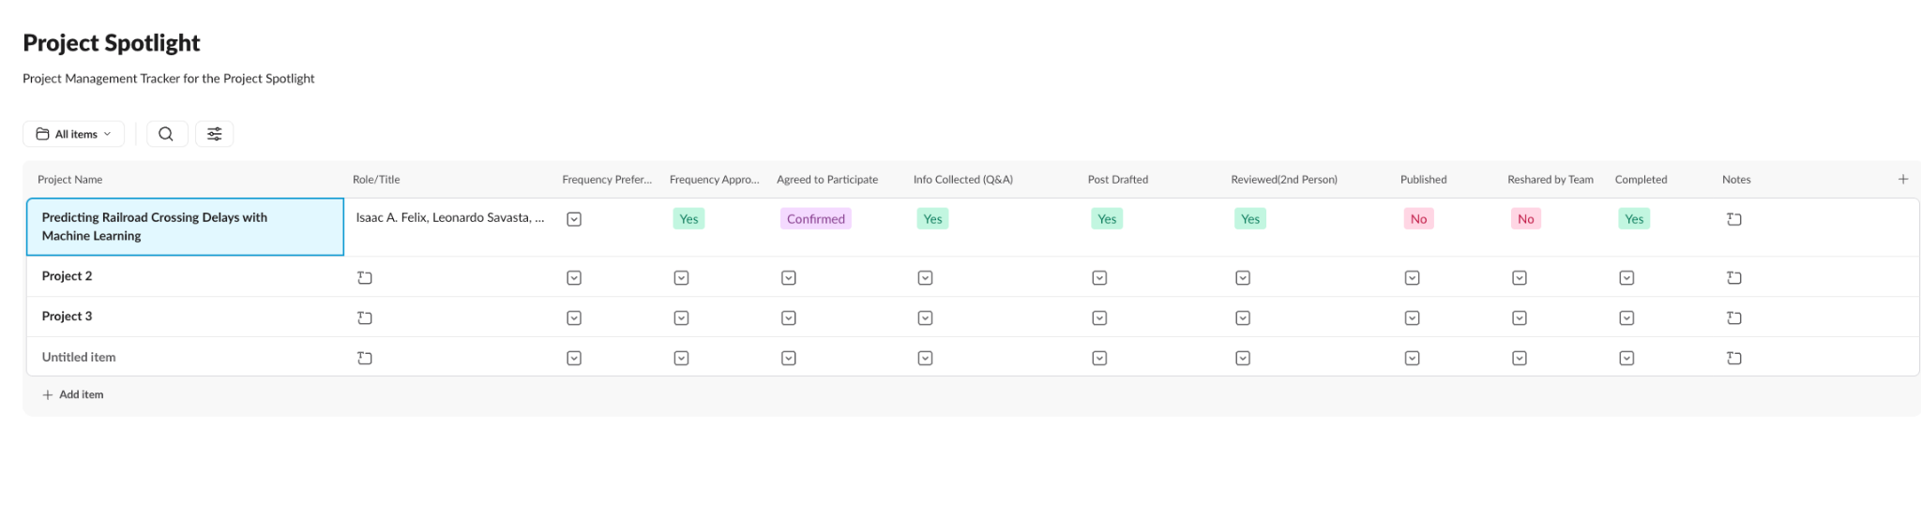
Project Spotlight Tracker
Tracker

Slide 27
Blog Posts

Slide 28
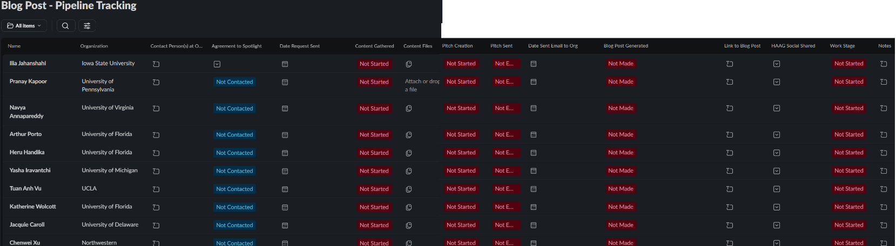
Blog Posts - Pipeline Tracking

Slide 29

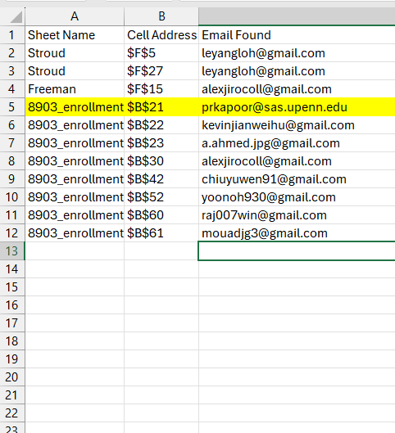
Blog Posts - Identify External Members Implementation
Critical Blocker
This step was formally identified and declared as a primary blocker for the blog post implementation workflow.
Outreach & Coordination
Riyam compiled a list by looking at Slack profiles of external comp advisors and calendar meeting invites.
Onboarding Integration
Recruitment initiatives require accurate personnel records integrated directly into the structured onboarding process.

Slide 30
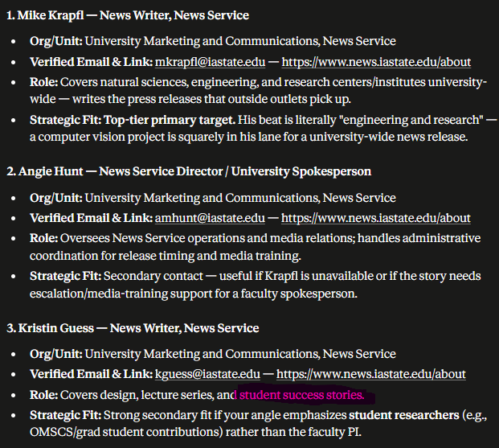
Finding Media Contacts at External Orgs
The Old Way
Hours spent digging through confusing university directories.
The AI Way (New)
Use a pre-made attachment prompt and add target organization & topic. Yields 5 verified contact names, positions, and emails.
Tested Validation
Successfully tested and verified with Iowa State University and computer vision project.

Slide 31
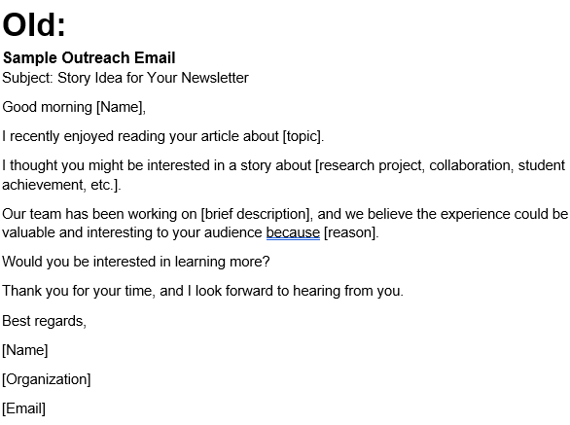
Blog Posts - Old Hook Email
Vague Inputs
The placeholders and input variables used in the sample outreach email are extremely vague.
Undefined Authority
Does not clearly define the authority or professional credibility of the sender.
Weak Collaboration Incentive
Does not provide a compelling reason for why the recipient should take on the collaboration.

Slide 32
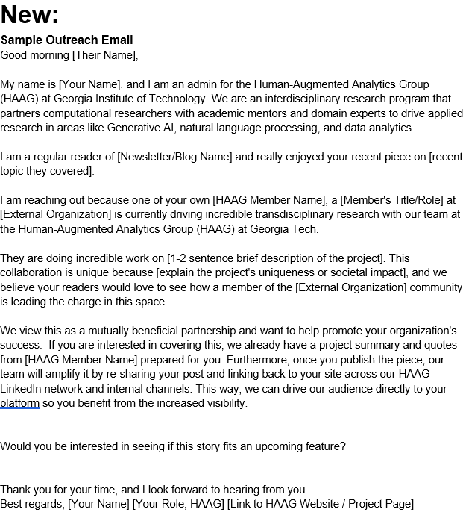
Blog Posts - New Hook Email
Clear Inputs from Slack Tracker
The placeholder variables are direct inputs from a filled Slack Tracker
Defined Authority
States who is sending the email and what HAAG is
Strong Collaboration Incentive
Does not provide a compelling reason for why the recipient should take on the collaboration.

Slide 33
Blog Posts - Next Step
Test the Process by getting more people initiated on the pipeline!

Slide 34
Internal Event Promotion

Slide 35
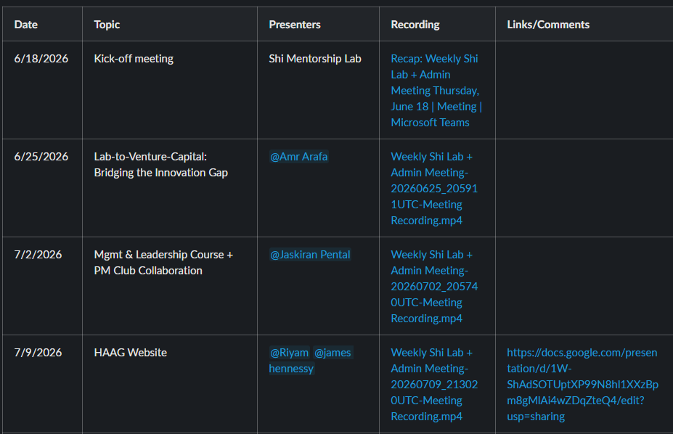
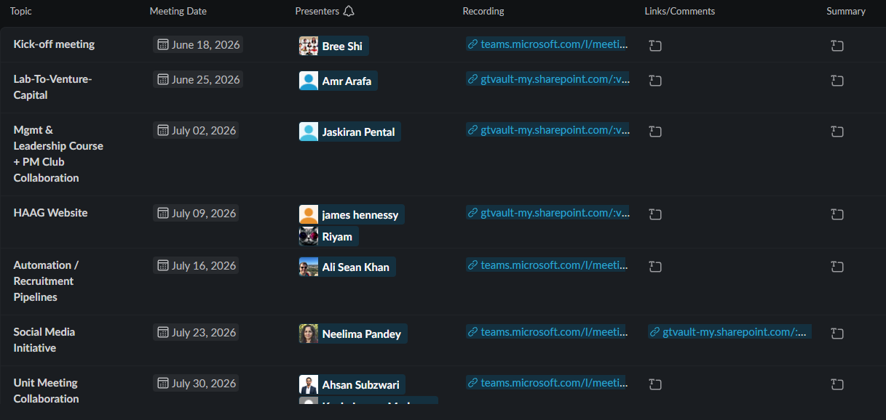
Internal Events Promotion — Lab Meeting Tracker
■OLD: Table
■NEW: Slack List

Slide 36
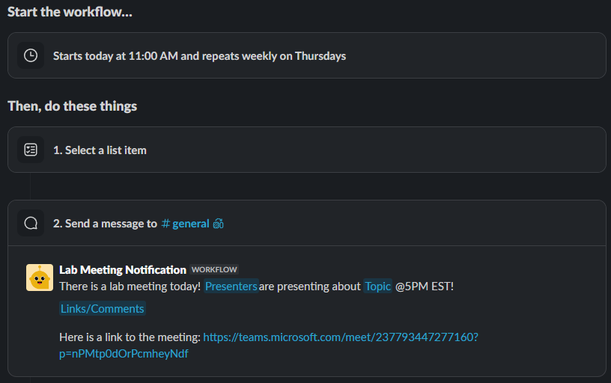
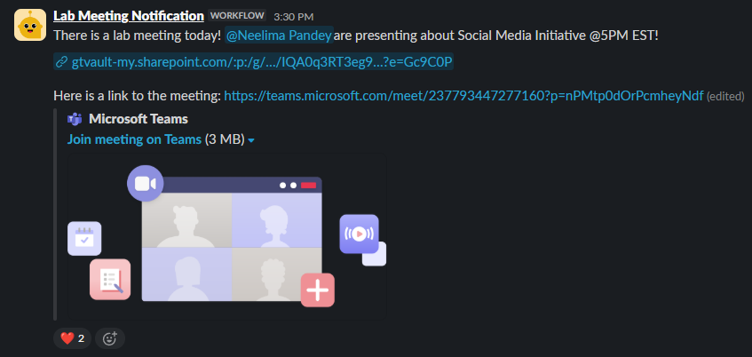
Internal Events Promotion - Notifications

Slide 37
External Event Promotion

Slide 38
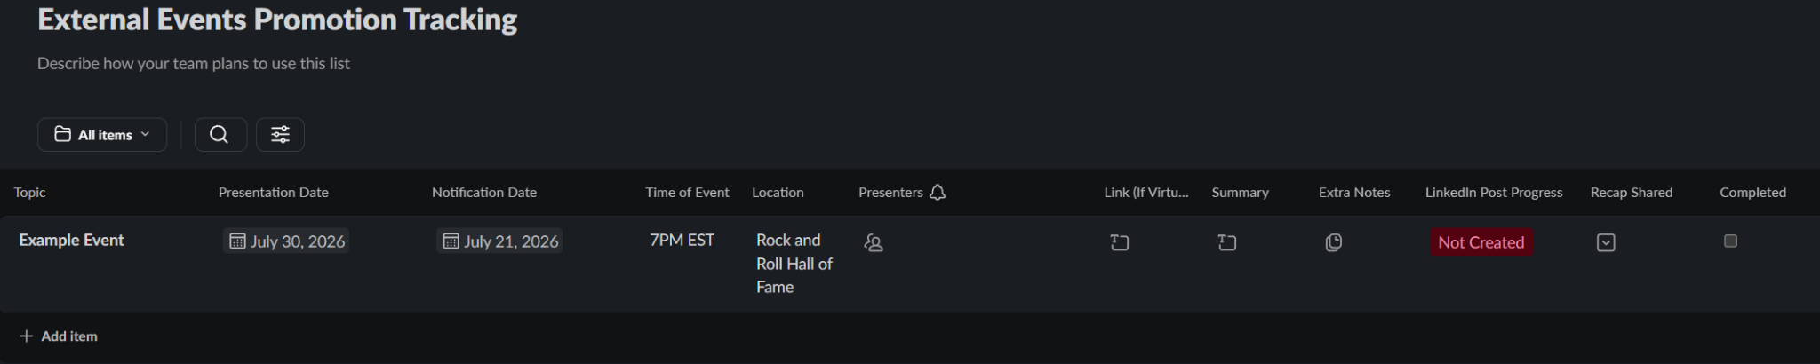
External Event Promotion - Tracking

Slide 39
External Event Promotion - Procedure
01
Identify & Track
Log event details (Topic, Date, Presenters) in the Slack External Events Tracker.
02
Gather Details
Request a high-quality visual or headshot from presenter via Slack/email.
03
Draft Post
Write attention-grabbing hook, body, tags, and call-to-action utilizing tracker info.
04
Review & Publish
Verify facts with presenter, post in #post-feedback, get approval, then publish live.
05
Promote Internally
Share live link on internal Slack channels and encourage team engagement.
06
Post-Event Follow-up
Draft and share a celebratory follow-up post highlighting key accomplishments.
07
Complete Tracker
Mark the event as completed in the tracking list for record keeping.

Slide 40
External Event Promotion - #Post-Feedback Process
01
Presenter Verification
Verify draft text, technical details, and visuals with presenters for accuracy.
02
Presenter Onboarding
Bring presenters into the private #post-feedback Slack channel.
03
Alert Admins
Post the draft in #post-feedback and direct reviews to the Slack thread.
04
Revisions & Feedback
Allow a 48-hour feedback window. Upload draft updates directly to the thread.
05
Final Review & Approval
Incorporate feedback. Obtain final approval from Bree or faculty before going live.

Slide 41
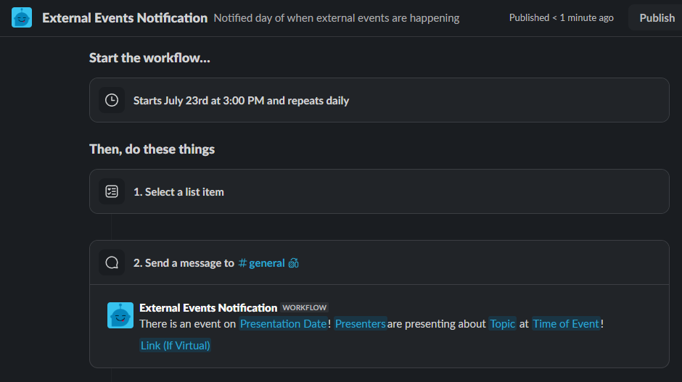
External Event Promotion - Notification

Slide 42

Individual Contribution
Jacob McGivern
Blog Posts
Tracker
External HAAG member process testing
AI Driven external org contact finder process with prompt
New Outreach Email
Internal Event Promotion
Lab Meeting tracker and Notification
External Event Promotion
Tracker with Notifications
New defined process document
#post-feedback procedure
Sheena Patel
Faces of HAAG
Tracker
Specific #Post-feedback process
Project Spotlight
Tracker
Implemented a Project Spotlight Post
New Process document
Specific #Post-feedback process

Slide 43
Future of Social Media Initiative

Slide 44
Next Steps
Getting people interested in participating in all content streams
Recruit People to be part of the social media initiative
Brainstorm and think about the use of LinkedIn Analytics
Need to finalize the announcement protocols when the drafts get posted in Slack for feedback
Need to validate the 48 hour window feedback cycle

Slide 45


Slide 46
Post Presentation Comments
Q: How do you validate the outreach increased based on these content streams?
A: The growth of the LinkedIn Group and likes/comments can be analyzed in the future. Being the second semester of the initiative, we just need better procedures in place (this semester’s work). Then, more posts can be created in each content stream. Finally, we can analyze how they’re doing and the growth from

